Slide 1

DAYALEKTOR
Belchez, Maica L. Carpio, Aira Joyce A. Gardon, Jana Marie G. Haboc, Florence Gail G.

Slide 2
Overview
Lean Canvas
Business Startup Cost
Revenue Projection
Online Surveys

Slide 3
Lean Canvas

Slide 4


Problems

Slide 5
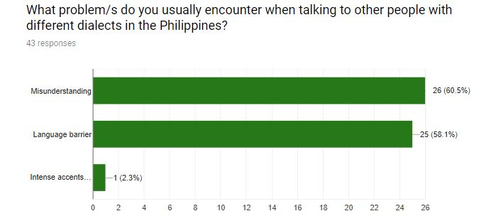

Slide 6
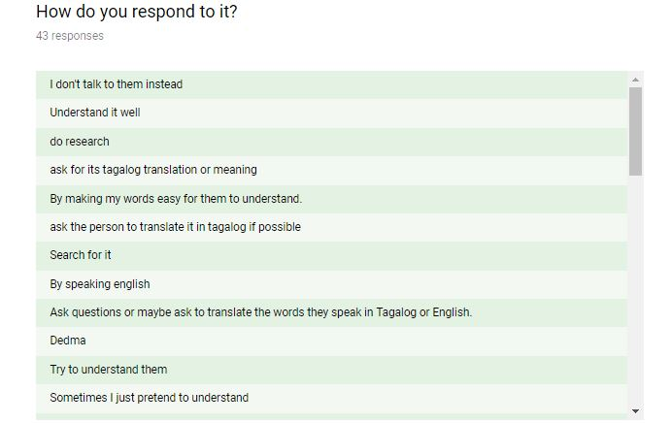
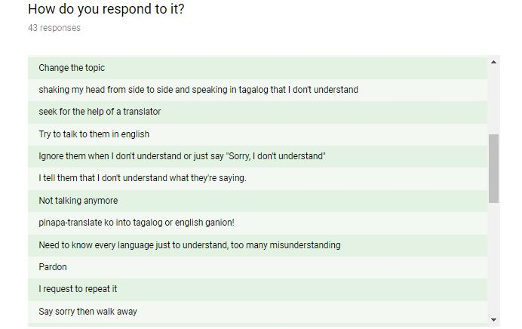
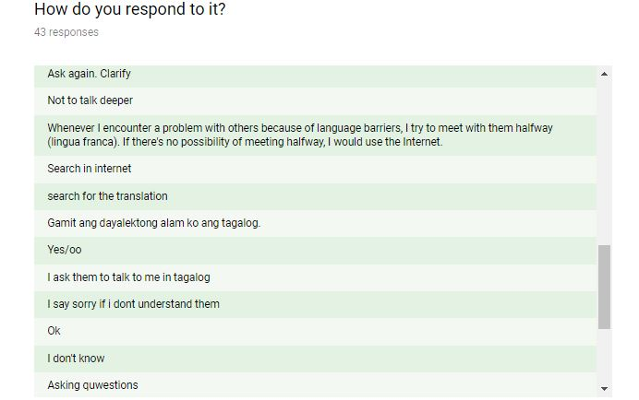
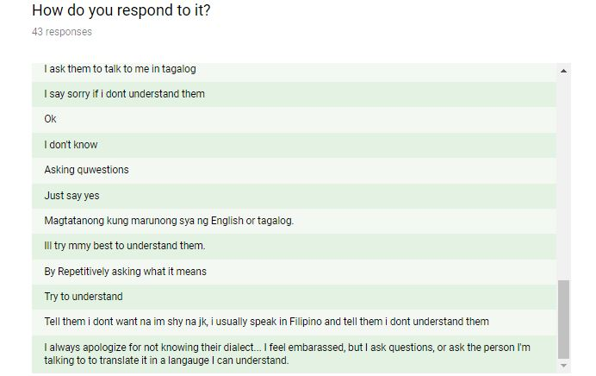

Slide 7



Solutions
Notes:
No more language barrier, Improve communication, lessen misunderstanding

Slide 8
Features
Philippine Dialects Translator
Offline Vocabulary Library
Word of the Day
Delegated Correction

Slide 9
Situational Benefits
Improve vocabulary and check pronunciation
Build self-confidence in talking to other people using other dialects
Make travelling in the Philippines so much easier

Slide 10
Marketing Message
“NEVER GET LOST IN TRANSLATION”

Slide 11
Channels
Social Networks
Blog
Advertisement
Email
Website

Slide 12
Customer Segments
Filipinos/Foreigners
Both female and male
18 and above
Tourists and Travelers

Slide 13
Travel Agency
Travel Company Website
D.O.T
Social Media Ads
Influencer’s Blog
Customer’s Feedback
Sales Funnel

Slide 14
Cost Structure
Mobile Development
Marketing
Advertising
Salaries
Utilities

Slide 15
Revenue Streams
Stakeholders
Paid Customers
Development Fees

Slide 16
Business Startup Cost

Slide 17
Personnel | Salary (monthly) | Duration (month) | Total
Project Manager | ₱36,667 | 18 | ₱660,006
Business Analyst | ₱18,841 | 6 | ₱113,046
Mobile Applications Developer (Android) | ₱26,667 | 18 | ₱480,006
Database Developer | ₱15,501 | 9 | ₱139,509
Quality Assurance Analyst | ₱12,112 | 3 | ₱36,336
 |  |  | ₱1,428,903
Software | Price | Duration (month) | Total
Android Studio | Free | 18 | -
Firebase | Free | 18 | -
SQLite | Free | 18 | -
 |  |  | -
Facilities/Utilities/Equipment/Furniture | Price | Duration (month) | Total
Working Space | ₱9,000 | 18 | ₱162,000
Computers | ₱60,000 | 18 | ₱60,000
Laptops (for backup) | ₱30,000 | 18 | ₱30,000
Tables (4) | ₱2,185 | 18 | ₱8,740
Chairs (4) | ₱980 | 18 | ₱3,920
Aircon | ₱2,413 | 18 | ₱2,413
Internet Access | ₱1,797.05 | 18 | ₱32,346.90
Electricity, Water | ₱2,568.21 | 18 | ₱46,227.78
 |  |  | ₱345,647.68
Advertisement | Price | Duration (month) | Total
Advertising | ₱10,000 | 18 | ₱180,000
Marketing | ₱20,000 | 18 | ₱360,000
 |  |  | ₱540,000
Contingency Cost | ₱53,236.52
Overall Total | ₱2,367,787.20

Slide 18
Revenue Projection

Slide 19
GOAL
₱1,774,550.68 in sales within 548 days
That’s 33 downloads at ₱100 each
The conversion rate is 2.35%, there will be 1,378 users a day

Slide 20
Online Surveys

Slide 21
Part 1 – Pain Points

Slide 22
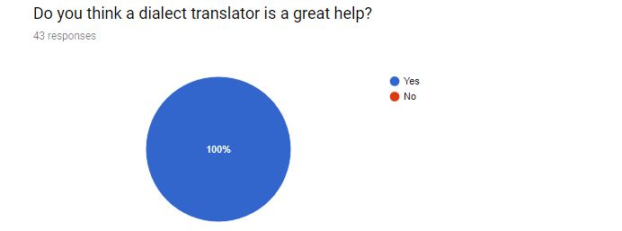
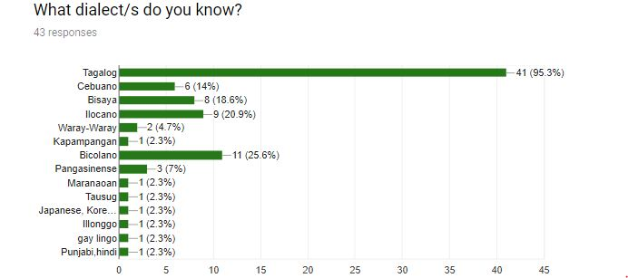

Slide 23
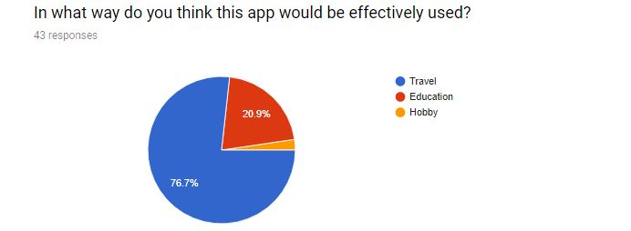
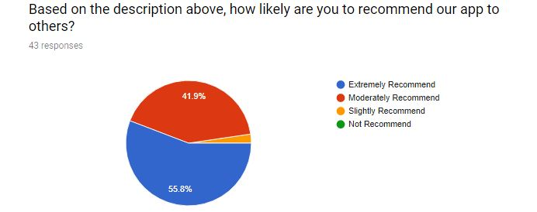

Slide 24
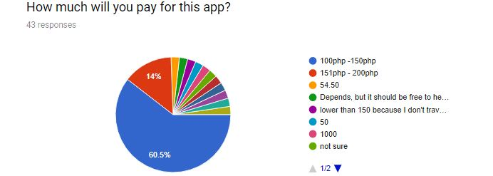
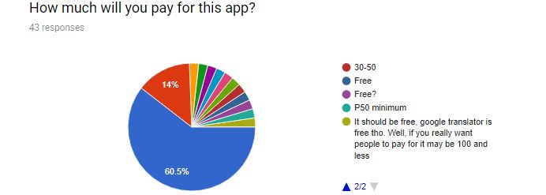

Slide 25
Part 2 – Features

Slide 26
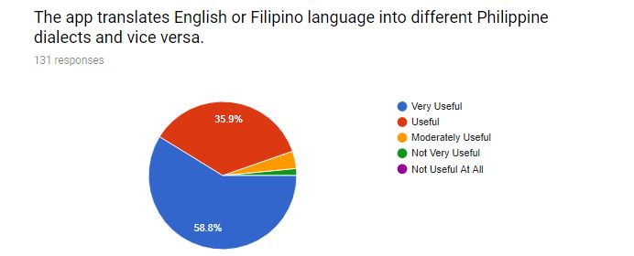
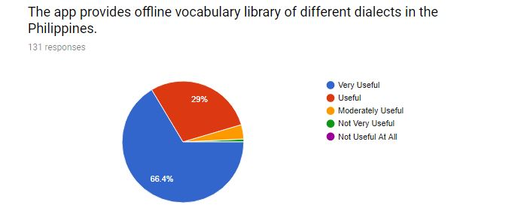

Slide 27
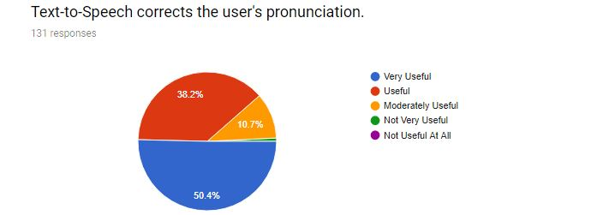
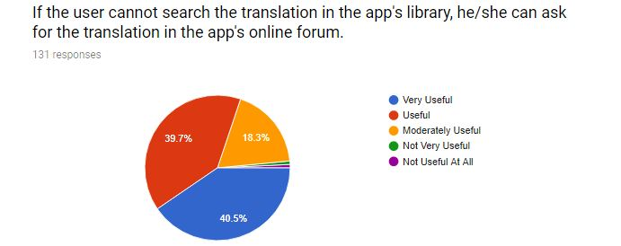

Slide 28
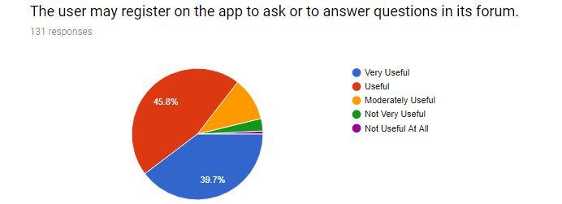
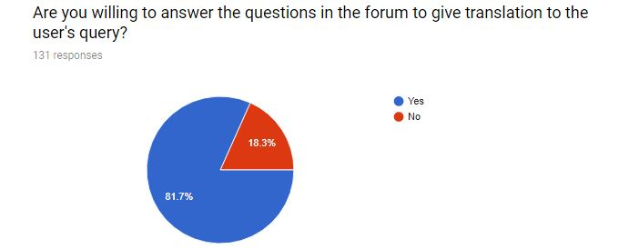

Slide 29
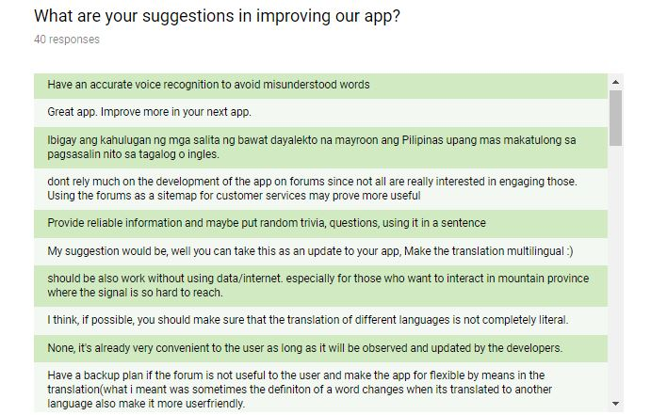
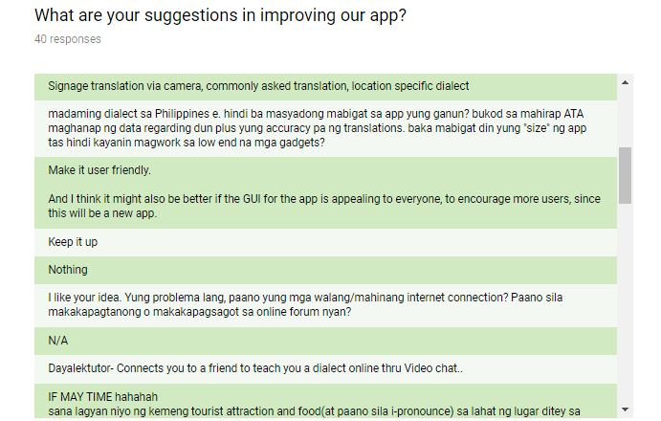
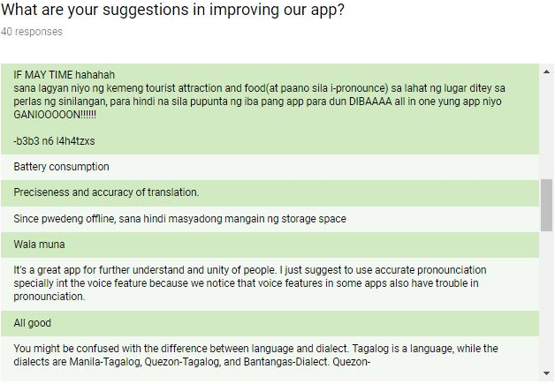

Slide 30
